Slide 1

STATE OF TEXAS v
JONATHAN OLSEN

Slide 2
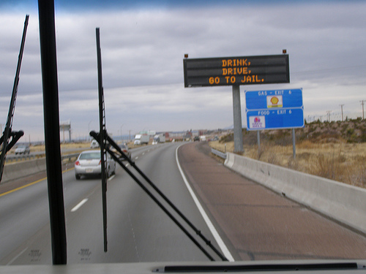
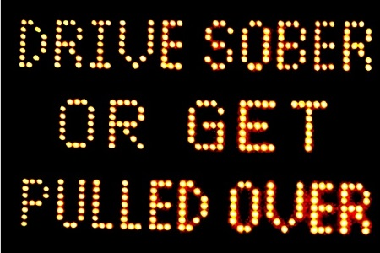
DRINKING
Drink, Drive, Go to Jail
Drive Sober or Get Pulled Over
Going Out Tonight, So Are We

Slide 3

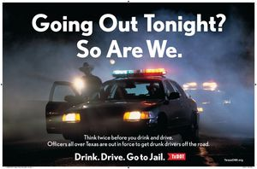

Slide 4
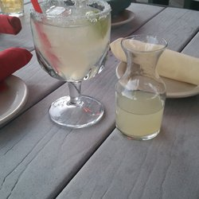
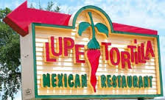
NOT ILLEGAL TO DRINK AND THEN DRIVE; as long as you’re NOT intoxicated

Slide 5
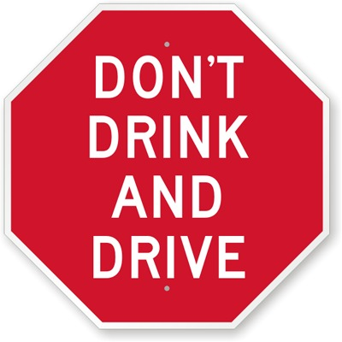
BUT WHO STILL SAYS…

Slide 6
DRINKING PATTERNS
A. REGULARLY
B. OCCASIONALLY
C. RARELY
D. NEVER
E. NOT ANY MORE

Slide 7
ALCOHOL
MEMBER OF MADD
MEMBER OF AA
STRONGLY AGREE WITH “NO REFUSAL” WEEKENDS
ALCOHOLISM IN FAMILY
NO ALCOHOL IN HOME
INJURED/VICTIM OF ALCOHOL RELATED CRIME

Slide 8


RELATED TO?

Slide 9


Slide 10
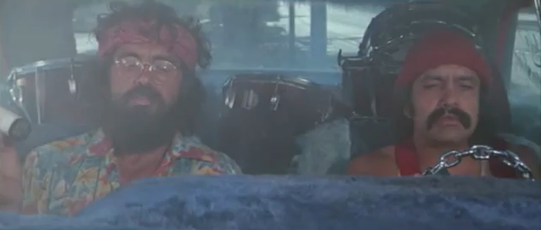
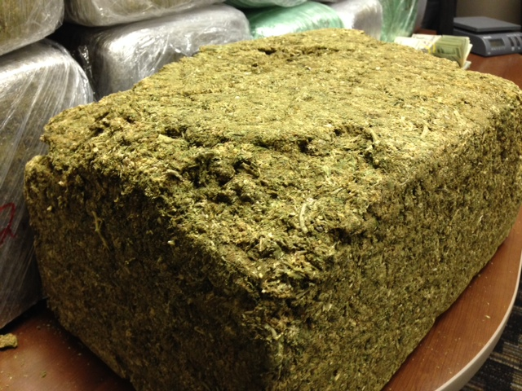

Slide 11
POSSESSION OF MARIJUANA
-In Possession At TIME OF STOP
=
DRIVING WHILE INTOXICATED
-In System AT TIME OF STOP/DRIVING

Slide 12
FORENSIC v. MEDICAL
Happy Everyday Airlines – hypothetical
  Best prices, clean, 1 free checked bag UNDER 50lbs
  If you lie and bag over 50lbs - $2k and 180 days in jail
  Bubba – big guy (300 lbs), lifts bags all day, FAA license
  How do you measure? GC scale too long & expensive
  HEA scale – Bubba measures his weight, then grabs bag, and subtracts weight
  SNOW – unusual, snow boots, hat, gloves, big coat, big breakfast, chili lunch, lots of water
  How does that make you feel?

Slide 13
FORENSIC v. MEDICAL
Problems:
  Did he tare the scale?
  Subtract clothes, food, drink in order to be reliable
Problem with Scales: naked or rocks in pockets
Can’t differentiate where weight comes from!
200lb bag – 4x the limit, know how it looks
Common Sense vs. Ridiculous Number

Slide 14
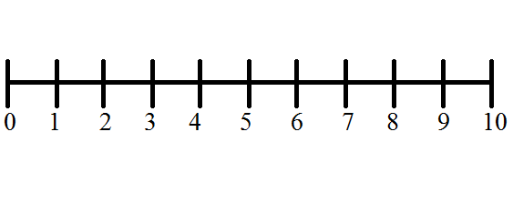
PRESUMPTION OF INNOCENCE
INNOCENT GUILTY

Slide 15
ASSUME
v.
PRESUME

Slide 16
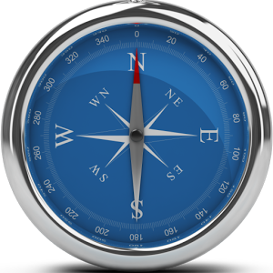

PRESUMPTION OF INNOCENCE

Slide 17
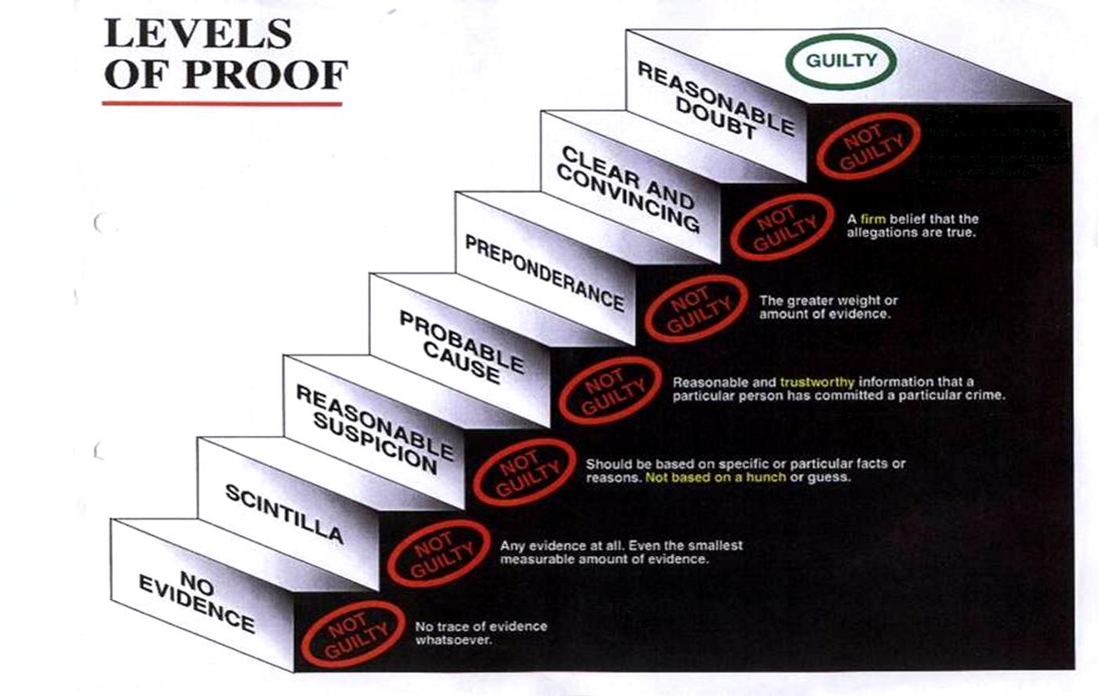

Slide 18
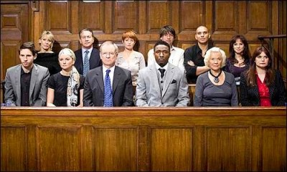
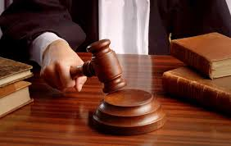
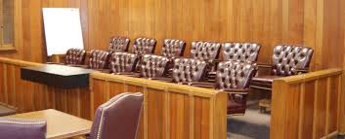
JURY SERVICE

Slide 19
THANK YOU

